Slide 1
By the numbers
20,000+ email records across 10 subscriber lists
144 standing web pages
Plus 1,000+ temporary web pages
30 social media accounts across Facebook, Instagram, Twitter, LinkedIn, YouTube
Monthly events, webinars, programs, digital videos, fundraising, and more
Two full-time and one part-time marketing staff
Collaborations with multimedia, radio, TV production, digital initiative, events, education, and Outreach Marketing

Slide 2
Marketing Support
Programming
WPSU Program Guide
Town & Gown ad, Centre Co Gazette, and advertising
Digital Editorial Calendar and Digital Initiative
Weekly fan email and monthly member email
Weekly News Roundup email
Membership
Email donor recognition
Fundraising Drives: email, social media, advertising
Member Events
Fundraising events such as Restaurant Giveback Nights and Connoisseur’s Dinner
Business Support
One sheets for program and event sponsorships
Audience research proof of performance
Business recognition
Education
Monthly email newsletter
Activity packets, posters, and other collateral
Interstitials
Webinar marketing
Websites
Events
Marketing
Event collateral
TV and FM promos
Engagement
Impact Reports (CPB, Quarterly, Annual)
Impact Mapping and Data Visualization
Member Survey
Presentations
Outreach Marketing
University Editor review and number release
Press releases, pitches, stories
Research projects

Slide 3
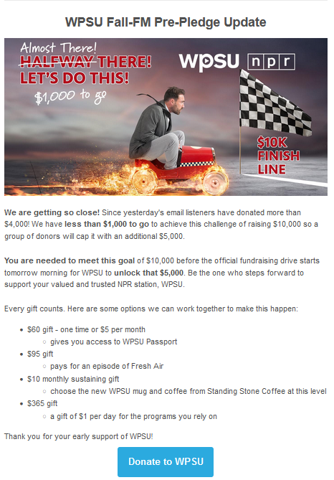
FM Prepledge $10,000 Challenge
5,870 fans + some opt-in members
Sent at 8:46 a.m.
By 9 a.m. 644 had opened and 99 people clicked through to the donate page
Goal was met in 18 minutes

Slide 4
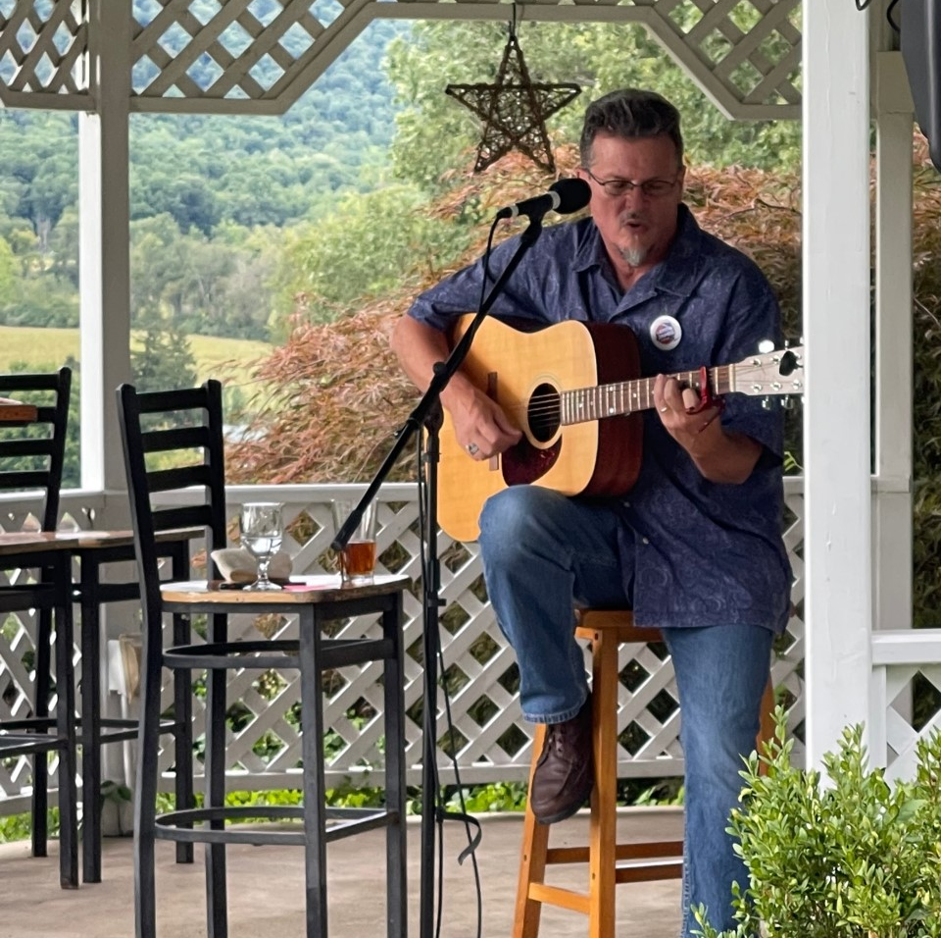
The Local Groove at RE Farm Cafe
September 8, 2022
Sold out September 6
80 registrations
Ticket income = $3,419.58
Sponsor income =$500 sponsor
FM promo, Facebook posts with boost, email campaign
$400 marketing budget

Slide 5
2022 Member Survey
Our internal goal = 700
Actual completion = 889
Questions about digital behavior: social media use, online videos, types of content, belonging
Initial Insights and Actions
Friday News Roundup
Passport how-to
Clean up, consolidation of user records across email lists and frequency
Continue with Facebook, Grow Instagram for 25-44 ages

Slide 6
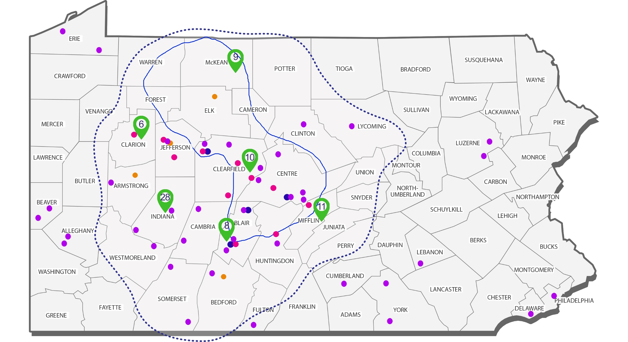
Impact Mapping Project
LAYERS
TV and FM service region
Intermediate Units
Education Outreach dots
Activity Data
Title | Movies in the Park
Date | 8/12/2022
County | Centre
Location Identifier | Lederer Park, State College
Community Partners | CRPR
Participants | 123
Notes:
Public Facing map with layer drop down menus to create views by categories like location, partners, activity descriptions, blended with national data sources like school or library locations, free lunch programs, and internet availability
Staff databases will be pointed to one data dashboard to track our success toward goal, metrics, and KPIs.

